Slide 1
Mathematics
Vectors
b
c
LabRat Scientific
© 2019
a

Slide 2
Scalar versus Vector
Scalar Quantities:
Quantities that can be completely characterized by a number and unit. In other words “direction” does not come into play.
Examples: length, mass, time, temperature, energy
Vector Quantities:
Quantities that behave like displacements (movement from one point to another).
Examples: velocity, magnetic field, acceleration, force

Slide 3
Vector Basics
A change in position of a particle is called Displacement.

Slide 4
Vector Basics
The direction and magnitude of the displacement can be depicted using a line and arrowhead.

Slide 5
Vector Basics
The starting and ending points are depicted using letters. This shows the particle moved from Point A to Point B.
B
In this application, the red line is known as a “displacement vector” which shows “net” displacement and direction of the particle.
A
The vector doesn’t necessarily represent the track the object followed, it just depicts the “starting” and “ending” state.

Slide 6
Vector Basics
B
This vector would generally be denoted as “vector AB”.
A

Slide 7
Vector Basics
However, it is also common for a short hand version to be used that doesn’t require the end points to be named. The vector at the left is called “vector a”.
a

Slide 8
Sample of Vectors Acting on a Pendulum
Force Vector (Tension)
Velocity Vector
Force Vector (Weight)
Acceleration Vector (g)

Slide 9
Vector Math
Engineers and scientists need to be able to add, subtract, multiply, and divide vectors in order to analyze complex engineering and scientific systems. This math can be done geometrically or analytically.
Geometric:
This “math” is performed by drawing the vectors to scale
This approach has limited utility, especially when things get complex
Analytical:
This math is performed by applying algebra and trigonometry

Slide 10
Vector Math - Geometric
If the particle moves along vector “a” and then along vector “b” it ends up at location C.
It is also possible to get to location C by going straight from Point A to Point C along vector “c”. Recall that a vector is independent of the path taken by the particle.
C
b
B
Vector “c” is known as the equivalent displacement vector.
c
a
A mathematical expression representing the equivalent displacement vector is:
a + b = c
A
It should be noted that the “+” in this expression does not have the same meaning as it has in scalar algebra.

Slide 11
Vector Math - Geometric
It doesn’t matter whether the particle follows vector-a first then vector-b to get the end point…
or if vector-b is followed first then vector-a. The end point is the same.
Vectors with the same magnitude and direction are considered to be the same vector. They can be moved around at will…
b
a
a + b
b + a
This fact enables the establishment of the Communicative Law for vectors:
a
b
a + b = b + a

Slide 12
Vector Math - Geometric
Now let’s look at three vectors to get from the start point to the end point.
There are several “routes” that can be taken to get from the start to end…
y
This fact enables the establishment of the Associative Law for vectors:
x
z
x + y
y + z
x + (y + z) = (x + y) + z
Start
x + y + z
End

Slide 13
Vector Math - Geometric
b
a
- b
Vectors can be positive or negative.
If the direction of a vector is flipped by 180 degrees, the new vector is the negative of the original.
b
It is apparent that the opposite b-vectors lead to two different points…
- b
a
a + b
a + (- b)

Slide 14
Vector Math - Analytical
The analytical method of adding vectors involves resolving the vector into its X and Y components.
Recall from trigonometry:
a_{y}
a
Hypotenuse (Hyp)
Sin (ϴ) = Opp / Hyp
Opposite (Opp)
ϴ
Cos (ϴ) = Adj / Hyp
ϴ
a_{x}
Adjacent (Adj)

Slide 15
Vector Math – Vector Direction Sign
The sign of the vector components are important in the addition and subtraction of vectors. To make the math work out properly, the angle (ϴ) must be referenced to the positive x-axis.
Cos (25⁰) = + 0.906
Cos (50⁰) = + 0.643
a_{y}
Cos (75⁰) = + 0.259
a
a_{y} = a * Sin (ϴ)
Sin(25⁰) = + 0.423
ϴ
Sin(50⁰) = + 0.766
Sin(75⁰) = + 0.966
a_{x}
a_{x} = a * Cos (ϴ)
Notice that all the values are positive…

Slide 16
Vector Math – Vector Direction Sign
The sign of the vector components are important in the addition and subtraction of vectors. To make the math work out properly, the angle (ϴ) must be referenced to the positive x-axis.
Cos (125⁰) = - 0.573
Cos (150⁰) = - 0.866
a_{y}
Cos (175⁰) = - 0.996
a_{y} = a * Sin (ϴ)
a
Sin(125⁰) = + 0.819
ϴ
Sin(150⁰) = + 0.500
Sin(175⁰) = + 0.087
a_{x}
Notice that the cos values are negative…
a_{x} = a * Cos (ϴ)

Slide 17
Vector Math – Vector Direction Sign
The signs of the vector components in the cartesian coordinate system are summarized as follows:
Cos (ϴ) = Negative
Cos (ϴ) = Positive
Sin (ϴ) = Positive
Sin (ϴ) = Positive
Cos (ϴ) = Negative
Cos (ϴ) = Positive
Sin (ϴ) = Negative
Sin (ϴ) = Negative

Slide 18
Vector Addition - Analytical
The x and y components for each of the vectors are as follows…
b
Recall the expression for the equivalent displacement vector:
c = a + b
b_{y}
b_{x}
c
a_{y}
c_{y}
The x and y components of the equivalent displacement vector can be expressed as follows:
a
a_{x}
c_{x}
c_{x} = a_{x} + b_{x}
c_{y} = a_{y} + b_{y}
Note that sometimes a “negative” vector component may be “added”…

Slide 19
Vector Addition - Analytical
EXAMPLE 1: If an airplane flew on a heading of 55 degrees for 200 miles then turned and flew on a heading of 15 degrees for 100 miles, how far to the north and east did the airplane fly?
c_{x} = a_{x} + b_{x}
b
100 mi
b_{y}
c_{x} = 200 cos (55) + 100 cos (15)
15⁰
b_{x}
c_{x} = 114.7 mi + 96.6 mi = 211.3 mi
a
c_{y}
a_{y}
c_{y} = a_{y} + b_{y}
200 mi
c
c_{y} = 200 sin (55) + 100 sin (15)
55⁰
c_{y} = 163.8 mi + 25.9 mi = 189.7 mi
a_{x}
c_{x}
We see that the airplane flew 211.3 miles to the East and 189.7 miles to the North.

Slide 20
Vector Math - Analytical
The magnitude of the Equivalent Displacement Vector can be determined by applying the Quadratic Formula ( a² + b² = c² ):
c = c_{x}² + c_{y}²
c
c_{y}
c_{x}

Slide 21
Vector Addition - Analytical
The total length of the equivalent displacement vector is calculated as follows:
c = c_{x}² + c_{y}²
c = (211.3 mi )² + (189.7 mi)²
284 mi
c
_{189.7 mi}
c = 44,647.7 mi ² + 35,986.1 mi ²
c = 284 mi
_{211.3 mi}

Slide 22
Vector Addition - Analytical
EXAMPLE 2: If the same airplane flew on a heading of 155 degrees for 200 miles then turned and flew on a heading of 15 degrees for 100 miles, how far to the north and east did the airplane fly?
c_{x} = a_{x} + b_{x}
c_{x} = 200 cos (155) + 100 cos (15)
b
c_{x} = - 181.3 mi + 96.6 mi = - 84.7 mi
100 mi
b_{y}
15⁰
b_{x}
a
c
c_{y}
c_{y} = a_{y} + b_{y}
a_{y}
200 mi
155⁰
c_{y} = 200 sin (155) + 100 sin (15)
a_{x}
c_{y} = 84.5 mi + 25.9 mi = 110.4 mi
c_{x}
We see that the airplane flew 84.7 miles to the West (- sign) and 110.4 miles to the North.

Slide 23
Vector Math - Analytical
The magnitude of the Equivalent Displacement Vector can be determined by applying the Quadratic Formula ( a² + b² = c² ):
c = c_{x}² + c_{y}²
c_{y}
c
c_{x}

Slide 24
Vector Addition - Analytical
The total length of the equivalent displacement vector is calculated as follows:
c = c_{x}² + c_{y}²
c = (- 84.7 mi )² + (110.4 mi)²
_{110.4 mi}
c
139.1 mi
c = 7,174.1 mi ² + 12,188.2 mi ²
c = 139.1 mi
_{-84.7 mi}

Slide 25
Vector Multiplication
Since vectors have direction and magnitude, vector multiplication cannot follow the same rules as scalar multiplication.
There are three multiplication operations that can be associated with vectors:
Multiplication of a vector by a scalar
Multiplication of two vectors in such a way that the outcome is a scalar
Multiplication of two vectors in such a way that the outcome is another vector

Slide 26
Vector Multiplication - Scalar Product
The idea of multiplying a vector by a scalar is rather simple to understand.
a
a
The product of a scalar and a vector is simply a vector whose magnitude is “k” times the magnitude of the original vector.
a
Vector_{new}
Vector_{new} = 3a
Example: If an airplane was flying at 200 km/hr on a heading of 60 degrees and the speed is doubled, the heading would still be 60 degrees, but the new speed would be 400 km/hr. The result is a vector…

Slide 27
Vector Multiplication - Scalar Product
Scalar (dot) Product -
a • b = ab cos (ϴ)
a
ϴ
“a” is a scalar quantity and represents the magnitude of Vector a
b
“b” is a scalar quantity and represents the magnitude of Vector b.
“cos (ϴ)” is a pure number
Since all of the values are either a scalar quantity or a pure number, the Dot-product yields a scalar product.

Slide 28
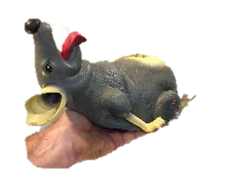
Vector Multiplication - Scalar Product
Louie the lab rat is dropped from Point A and falls to Point B. How much work does gravity do on Louie?
Work = Force x Distance
Work = a • b
A
Work = ab cos (ϴ)
0⁰
F = mg
d
Since gravity is making Louie fall straight down along distance “d”, the angle (ϴ) is 0⁰.
Work = (mg) d cos (0⁰)
B
Work = (mg) d
In this case the work is a positive value since the force is in the direction of the motion.

Slide 29
Vector Multiplication - Scalar Product
If Louie is lifted from Point A to Point B at a constant velocity (acceleration = 0). How much work is done on Louie?
Since the lifting force is in the direction of the motion, we define ϴ = 0⁰.
A
F_{Lift}
Since gravity is acting opposite the motion, we define ϴ = 180⁰.
d
F = mg
Looking at
Work = ab cos (ϴ)
cos (0⁰) = + 1
cos (180⁰) = - 1
B
In this case we see that the lifting force does positive work and gravity does negative work. The magnitude of each is the same since the motion has acceleration = 0

Slide 30
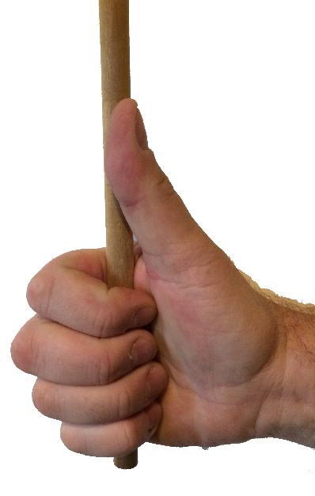
Right-hand Rule
Before moving on, the concept of the “Right-hand Rule” needs to be introduced.
The Right-hand Rule can be used to determine the direction of the vector (cross) product .
Using your right hand, curl your fingers such that they follow the rotation of a into b. Your thumb indicates the direction of the resulting vector product.
b
ϴ
a

Slide 31
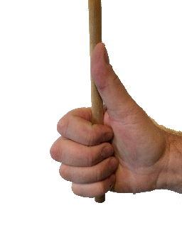
Vector Multiplication - Vector Product
a x b
Vector (cross) Product -
a x b = ab sin (ϴ)
b
Notice:
ϴ
The cross-product yields a vector.
a
a x b means the angle rotates from vector a towards vector b
b
ϴ
b x a means the angle rotates from vector b towards vector a
a
This means that vector a x b is not the same vector as b x a
b x a

Slide 32
Vector Multiplication - Vector Product
Example: A 4.0 N tangential force is applied to the edge of a disk with a radius of 0.5 m. What is the magnitude and direction of the resulting Torque Vector?
The magnitude is determined using the Cross-Product equation: a x b = ab sin (ϴ)
r x F = rF sin (ϴ)
For this example…
r x F = (0.5 m) (4.0 N) sin (90⁰)
F = 4 N
r x F = (0.5 m) (4.0 N) sin (90⁰)
r = 0.5 m
(radius)
90⁰
r x F = (0.5 m) (4.0 N) (1.0) = 2.0 Nm

Slide 33
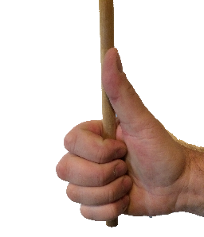
Vector Multiplication - Vector Product
The “sense” (a.k.a. direction) of the resulting vector can be determined by using the Right-hand Rule.
Rotating your finger from the radius vector in a counterclockwise direction towards the force vector results in your thumb pointing out of the top of the disk. This is the direction of the torque vector.

Slide 34
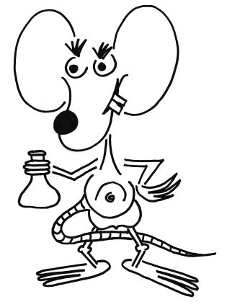
Questions ?

